Slide 1


Nebraska Drought Conditions:
CARC Update
November 7, 2023
Brian Fuchs
National Drought Mitigation Center
University of Nebraska-Lincoln
School of Natural Resources

Slide 2
Regional Climatic and Drought Conditions…

Slide 3
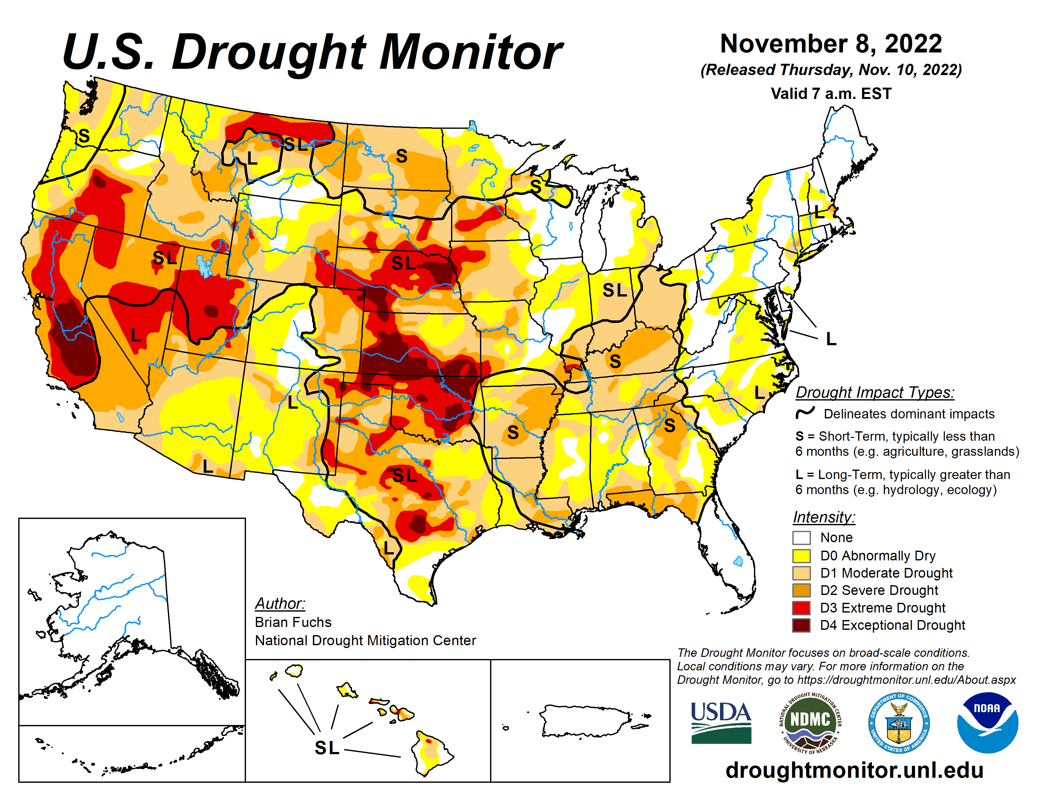
Last year at this time…..

Slide 4
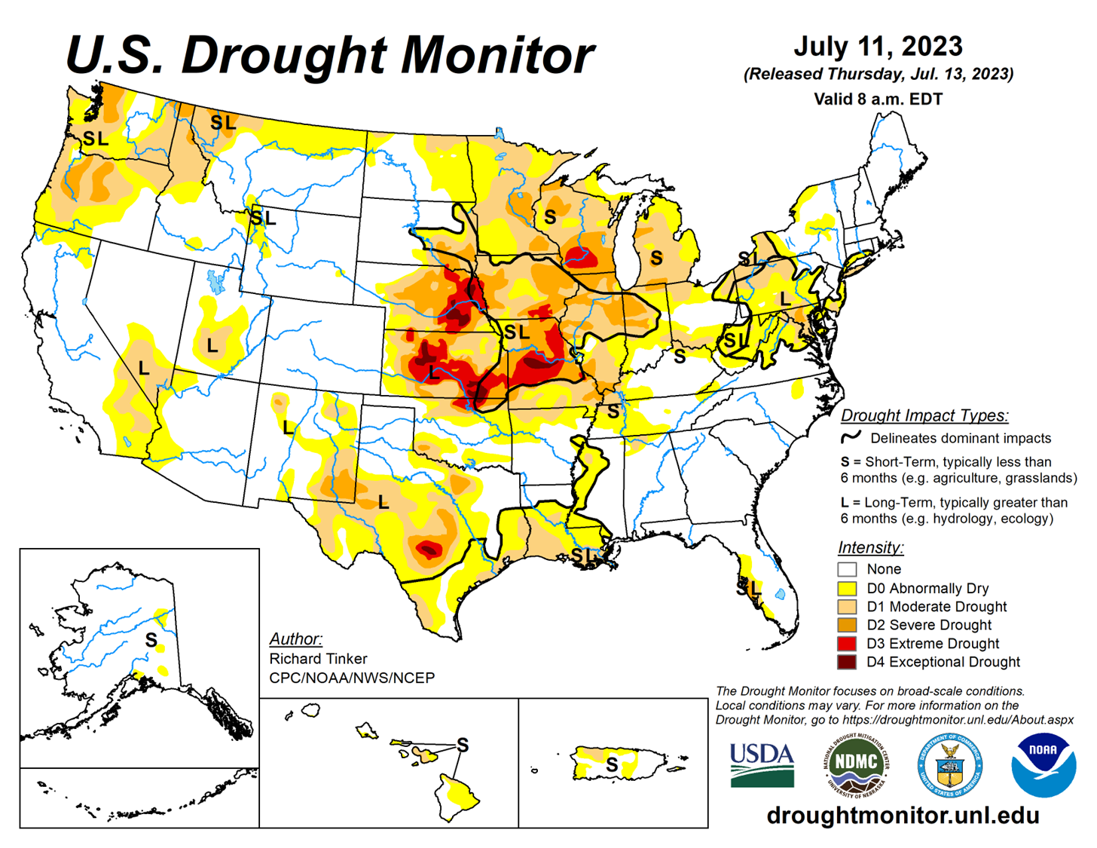
Last CARC Meeting…..

Slide 5
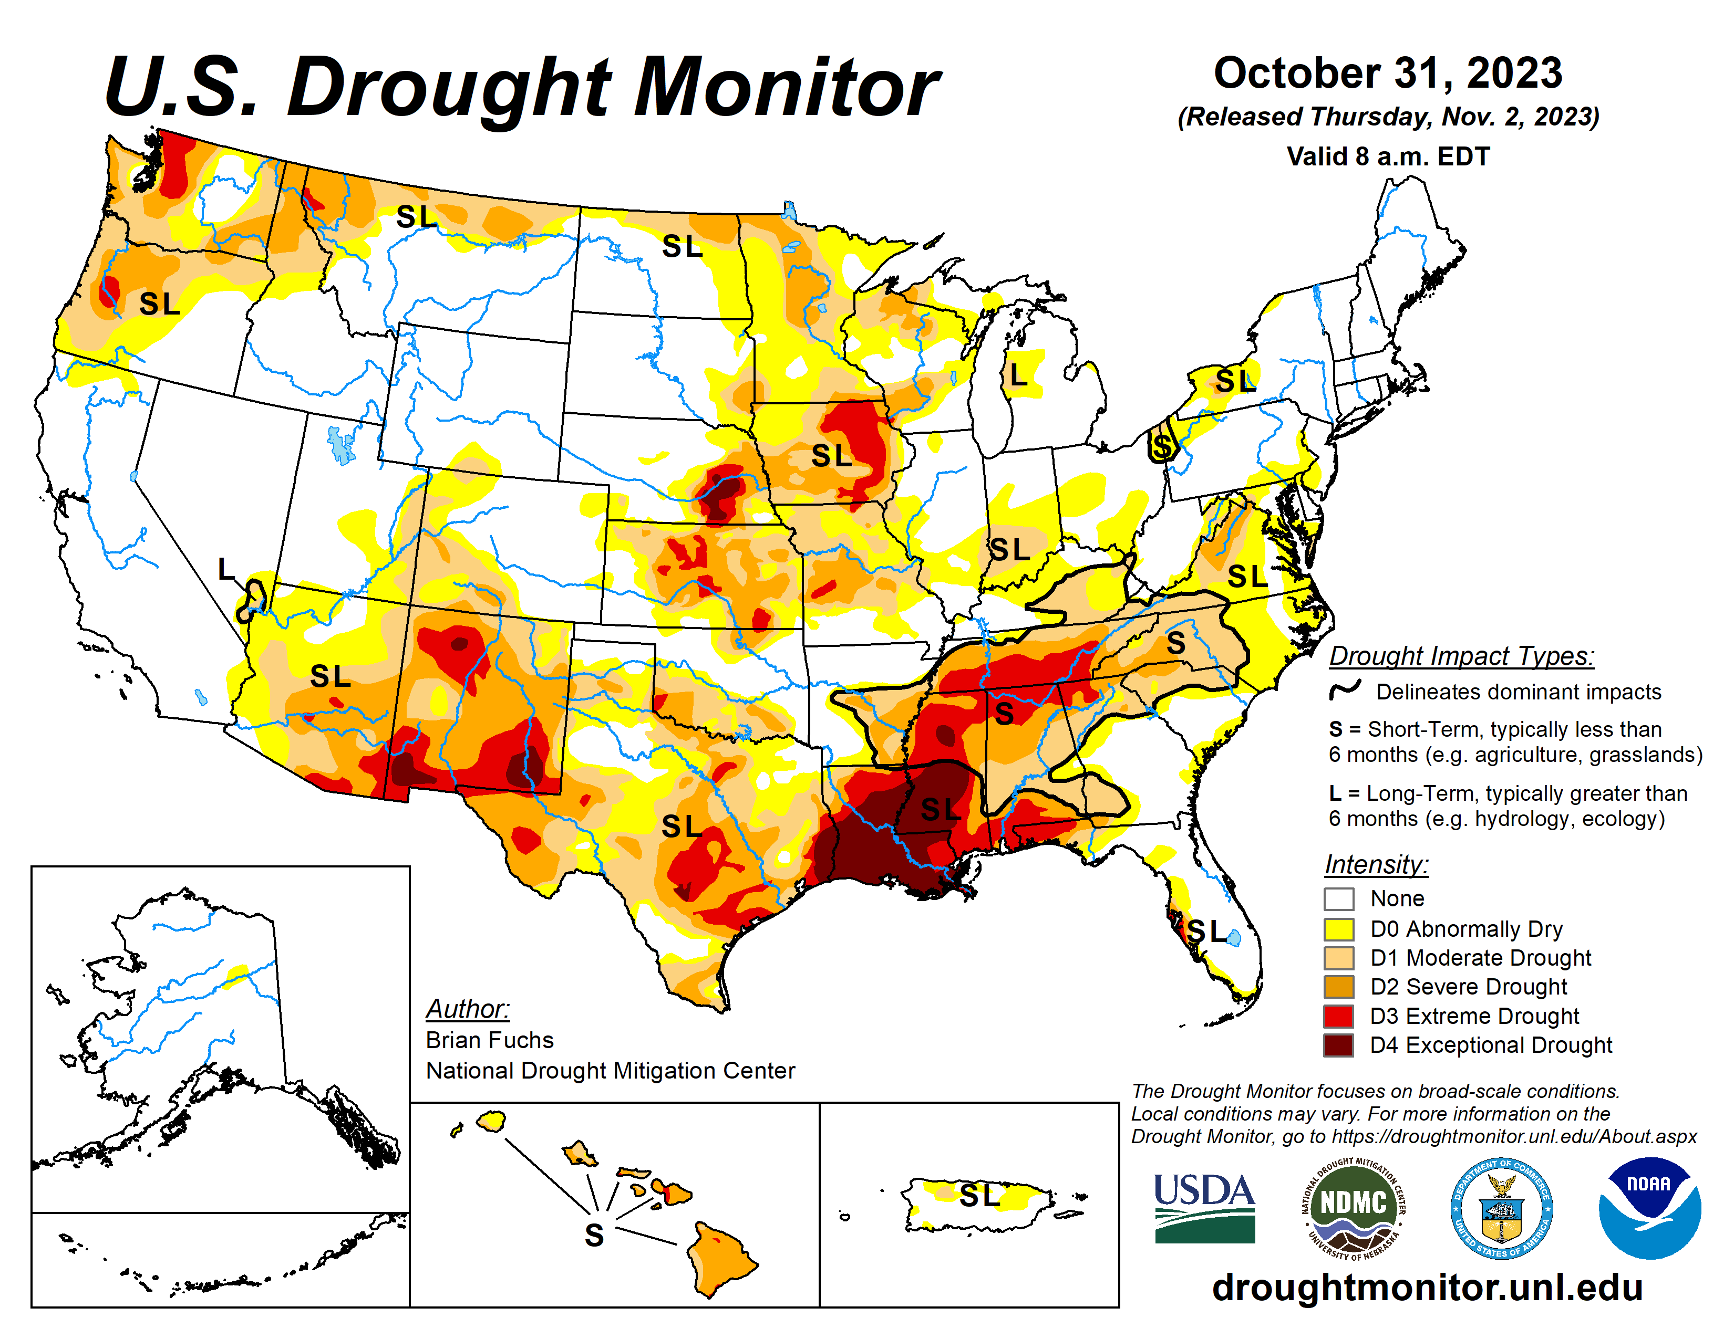

Slide 6
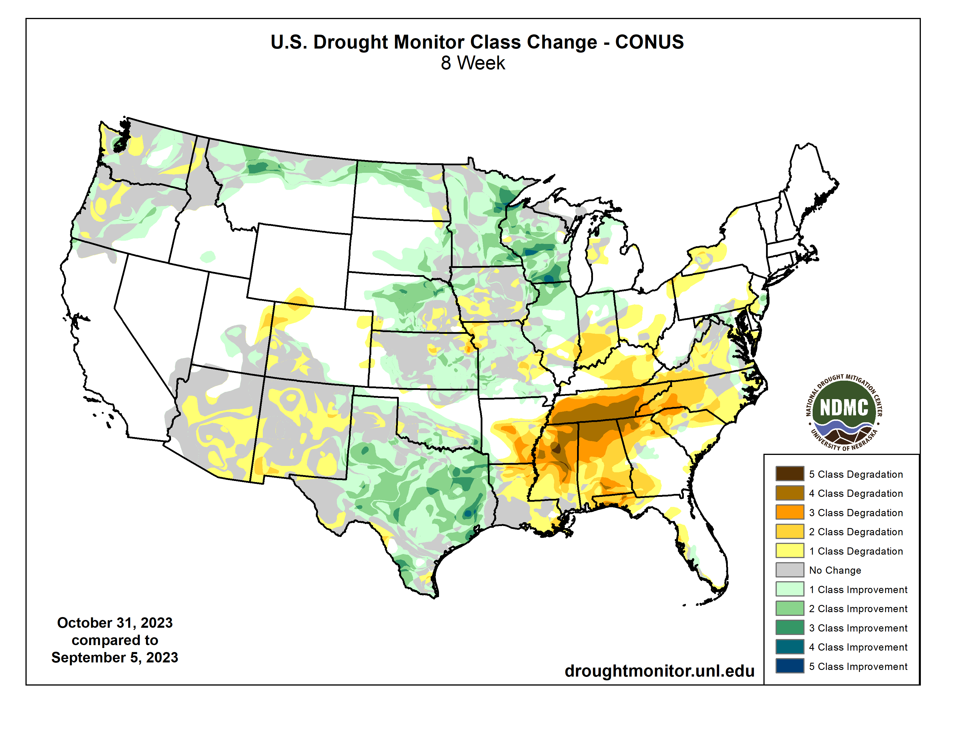

Slide 7
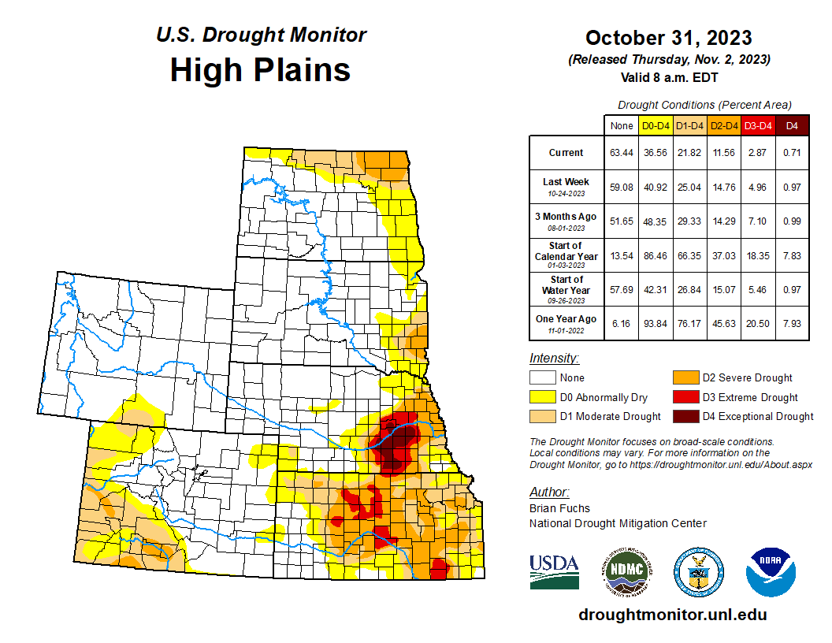


Slide 9
Last CARC meeting

Slide 10
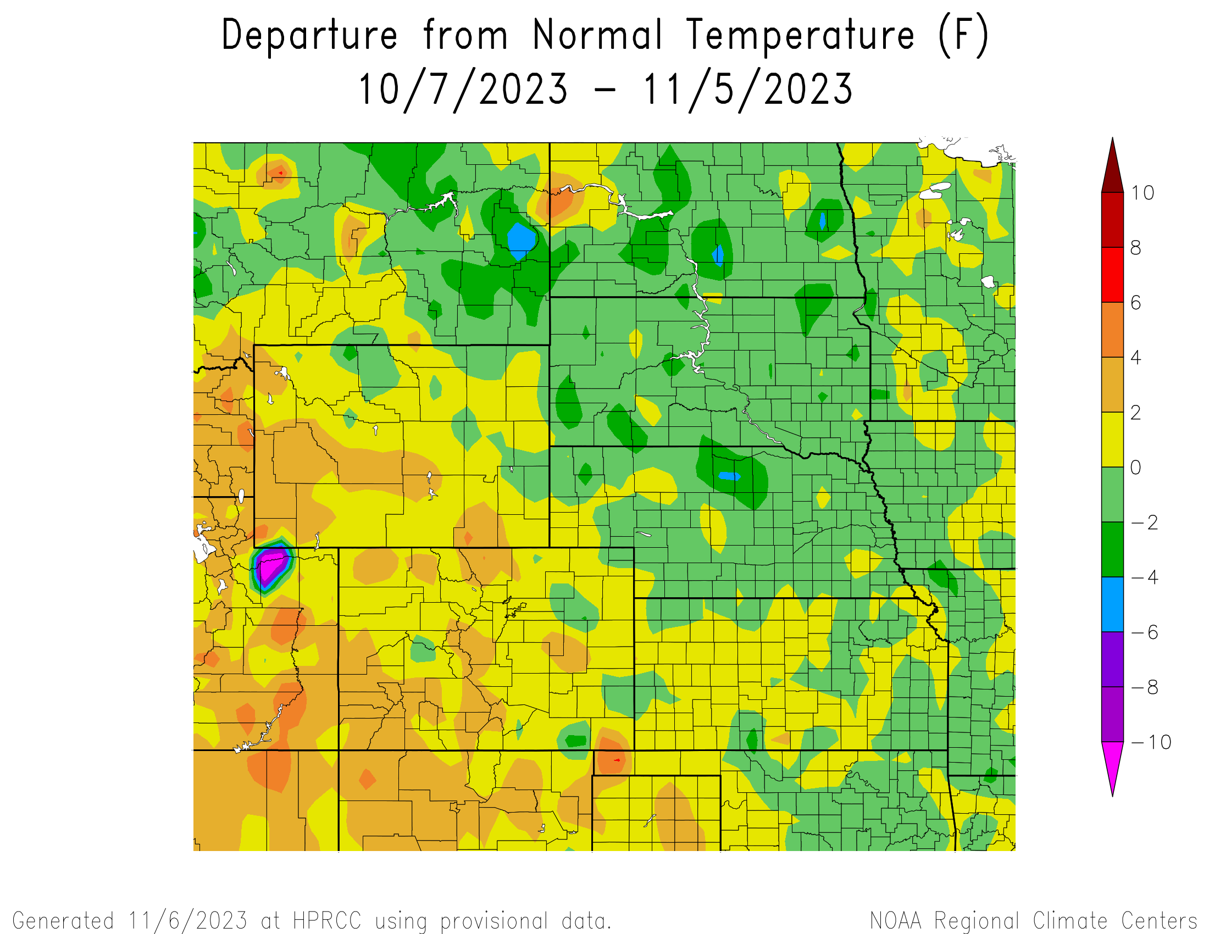
Departure from Normal Temperatures over the last 30 days

Slide 11
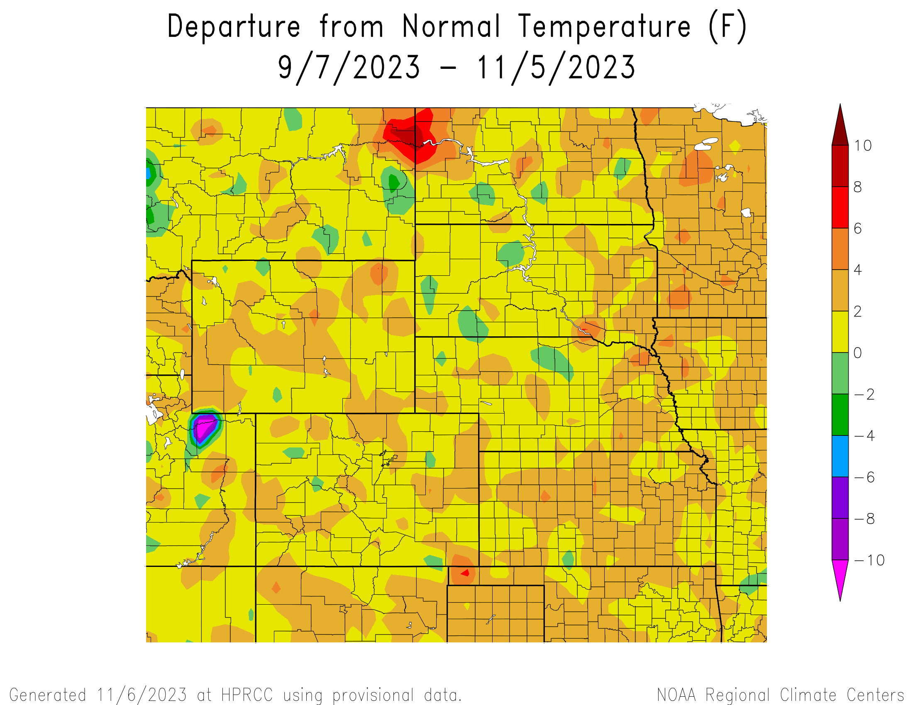
Departure from Normal Temperatures over the last 60 days

Slide 12
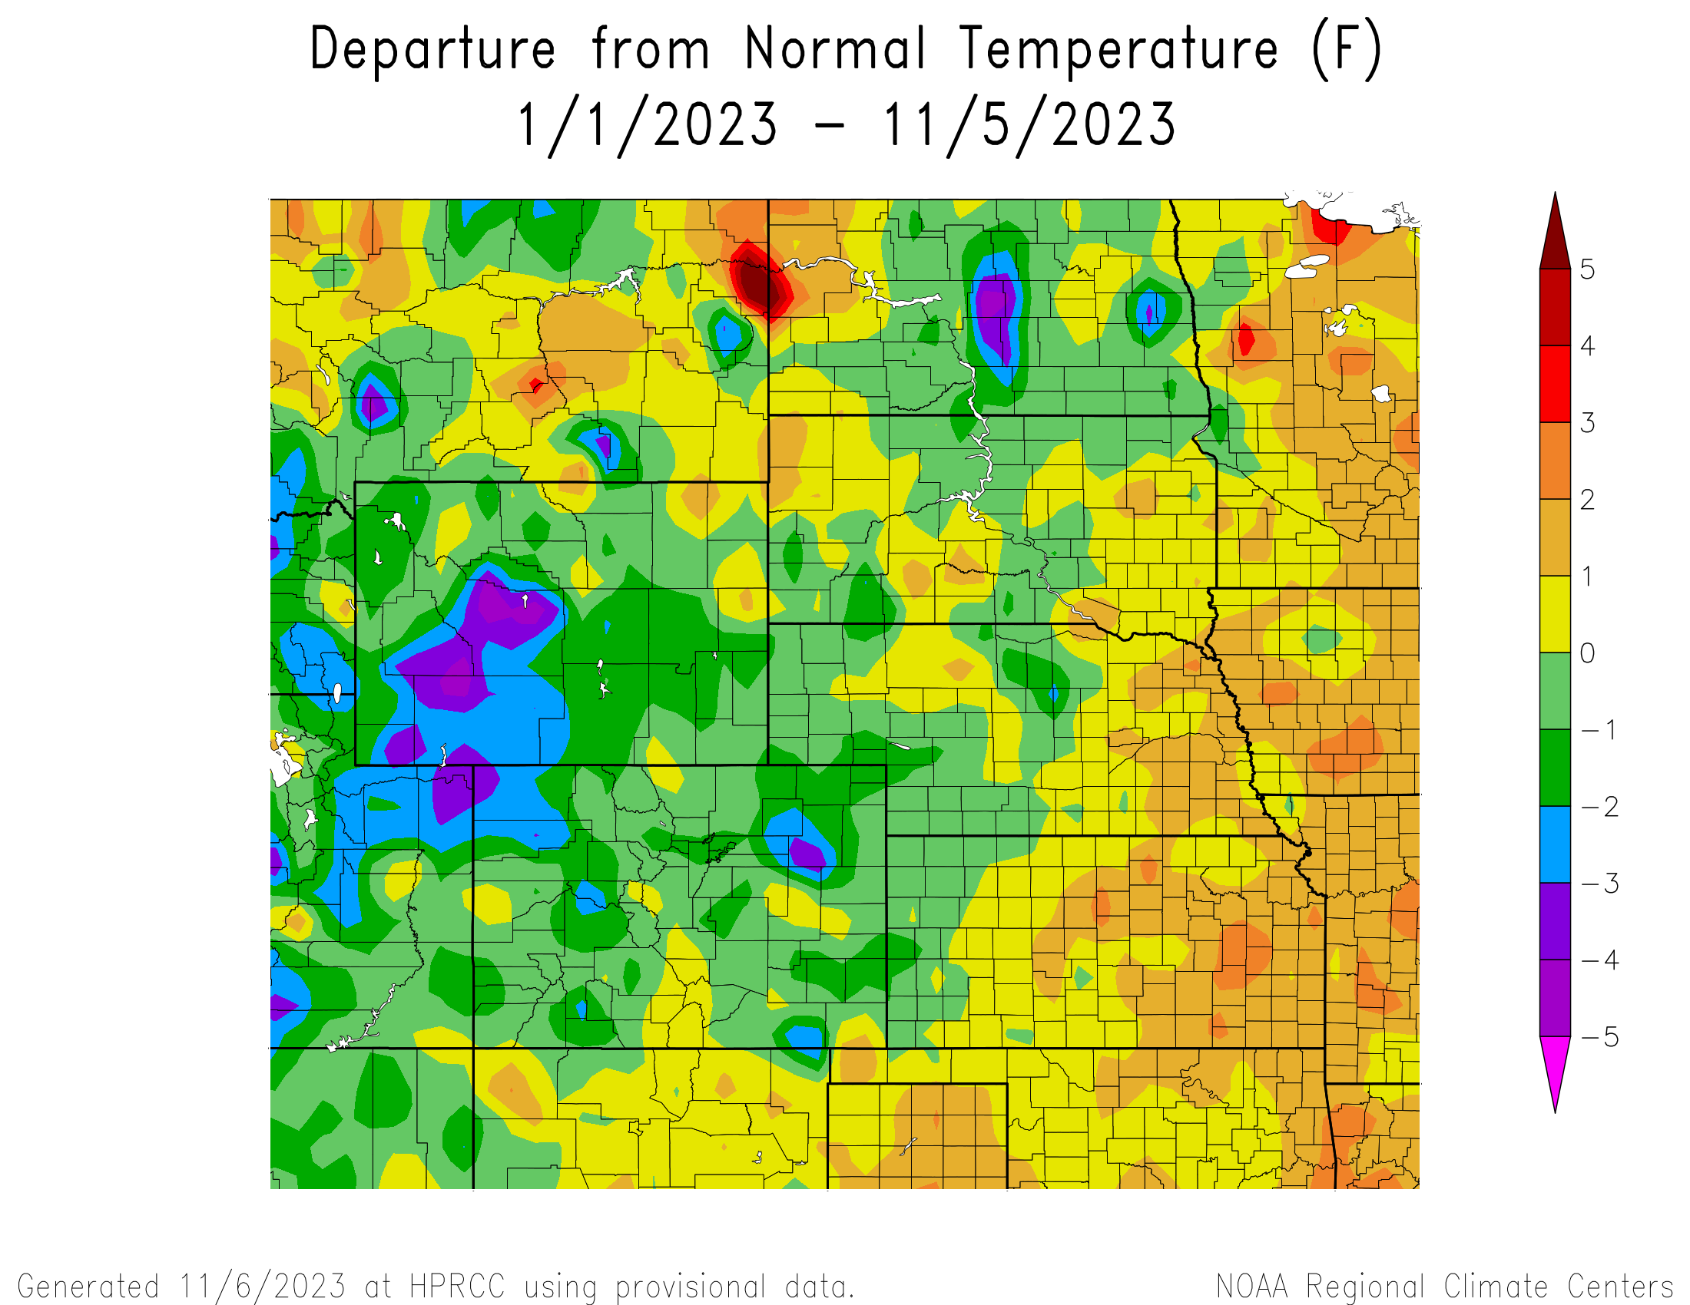
Departure from Normal Temperatures for the Calendar Year

Slide 13
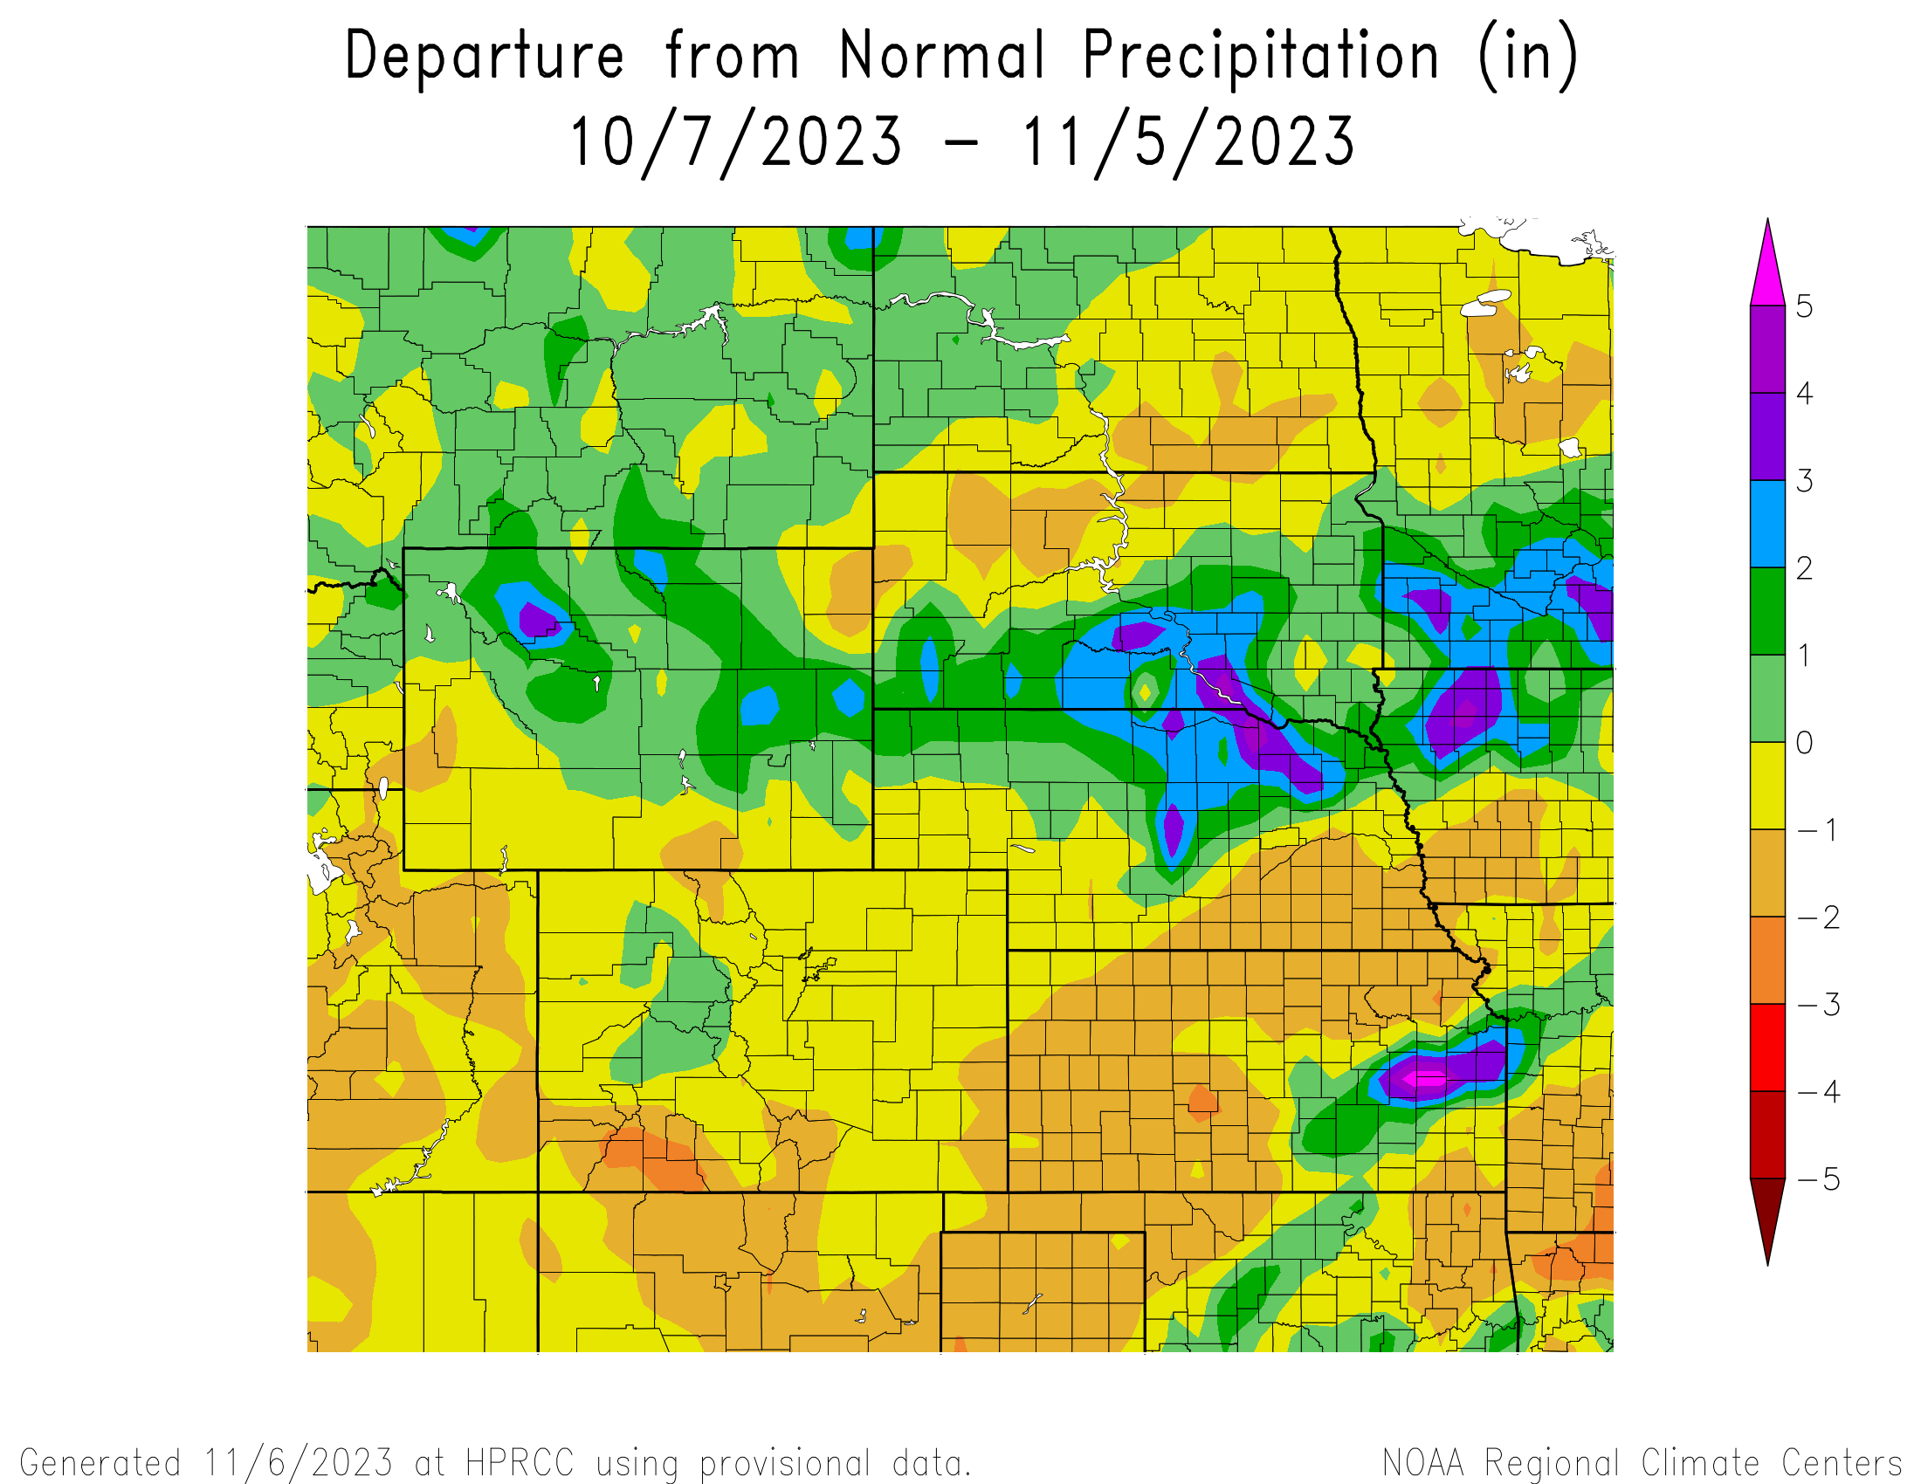
Percent of Normal Precipitation over the last 30 days

Slide 14
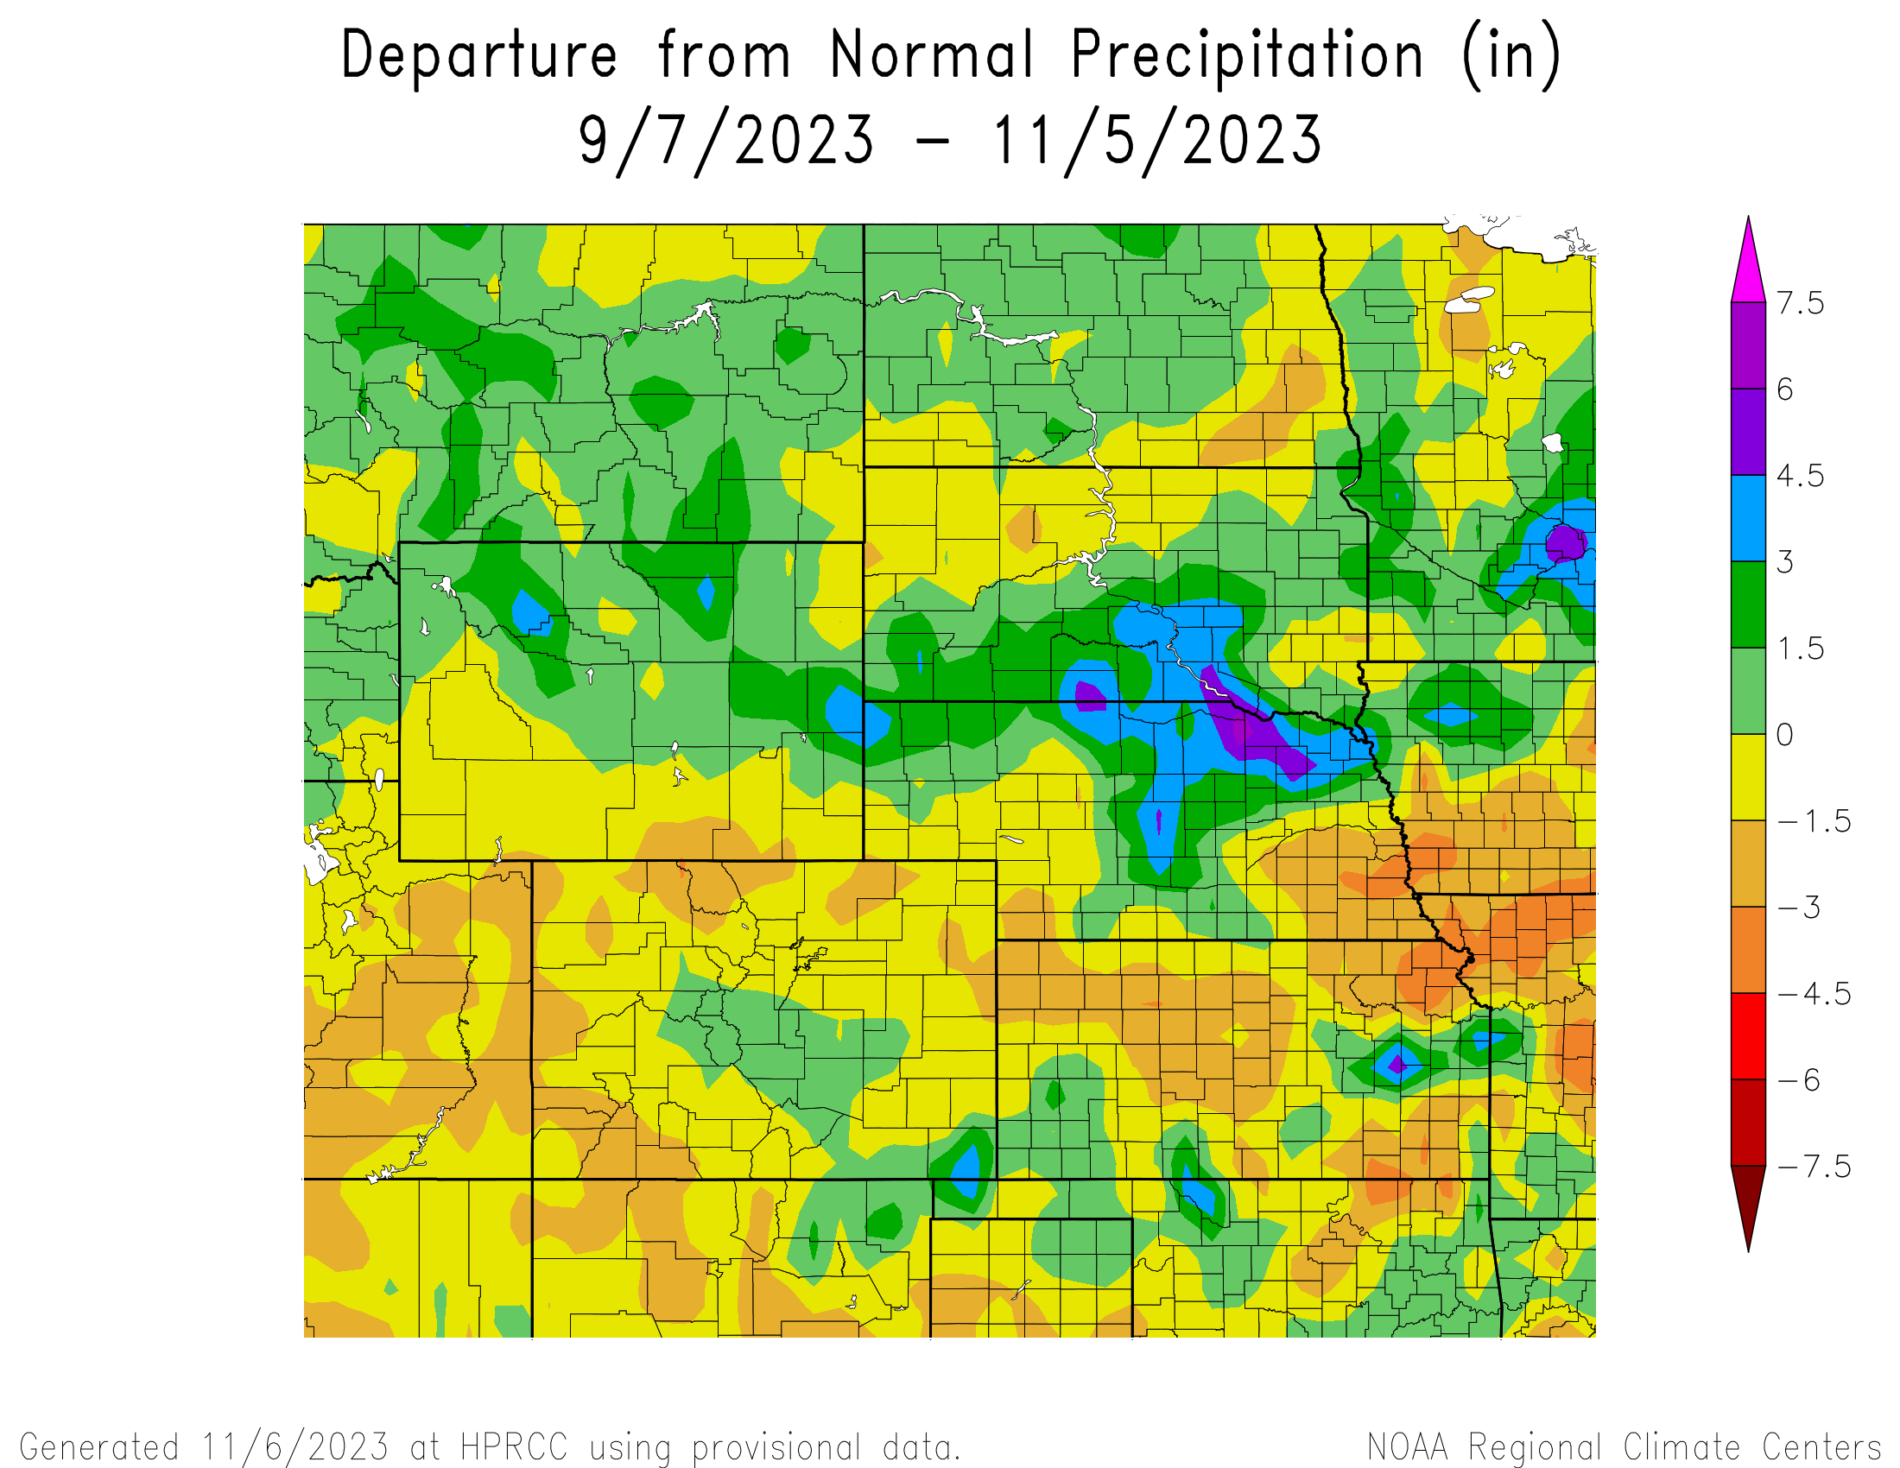
Percent of Normal Precipitation over the last 60 days

Slide 15
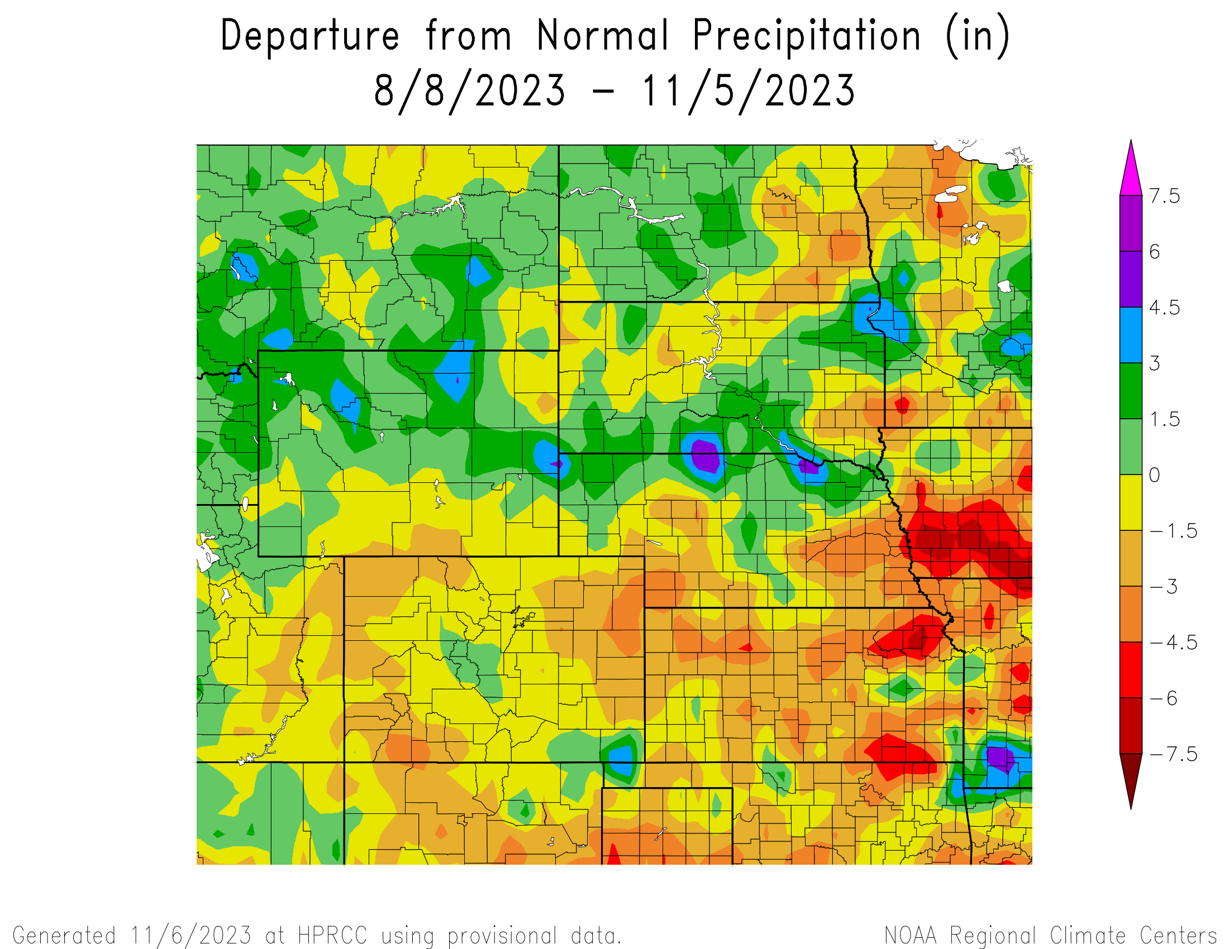
Percent of Normal Precipitation over the last 90 days

Slide 16
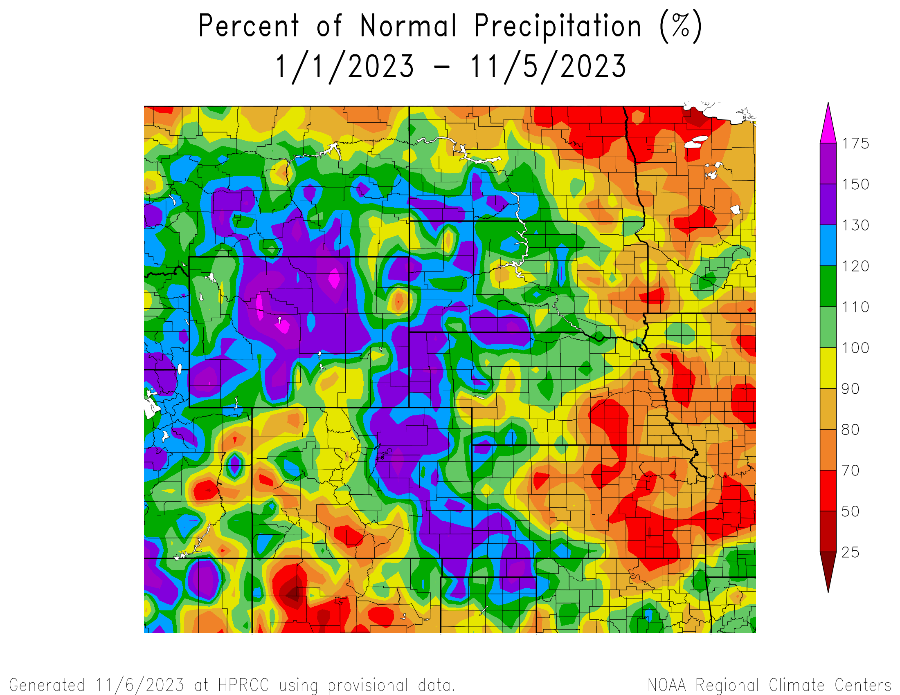
Percent of Normal Precipitation for the calendar year

Slide 17
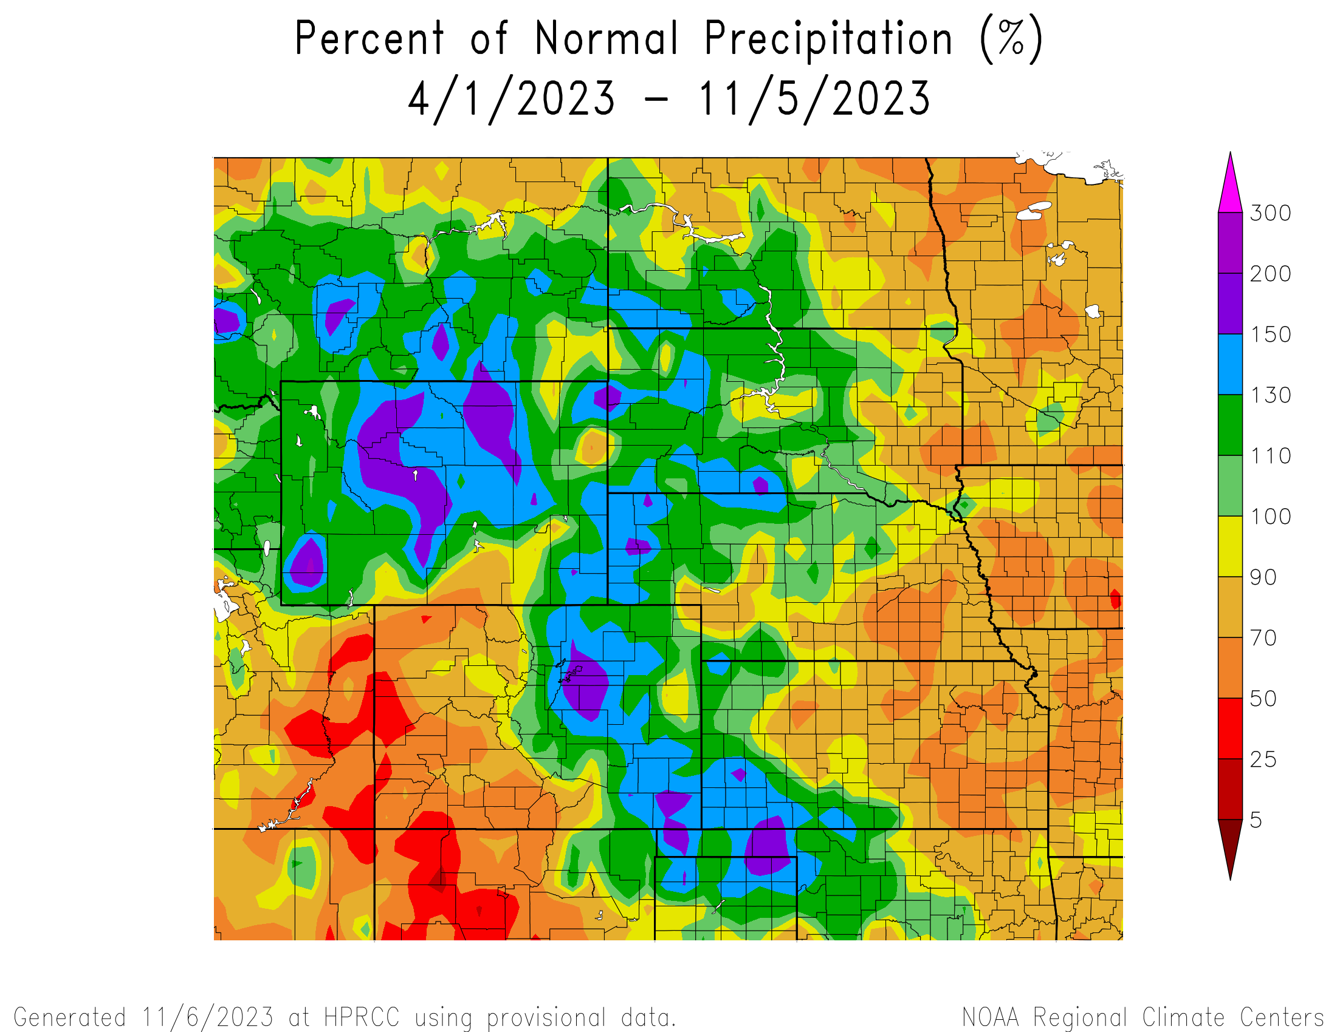
Percent of Normal Since April 1
2023
(growing season)

Slide 18
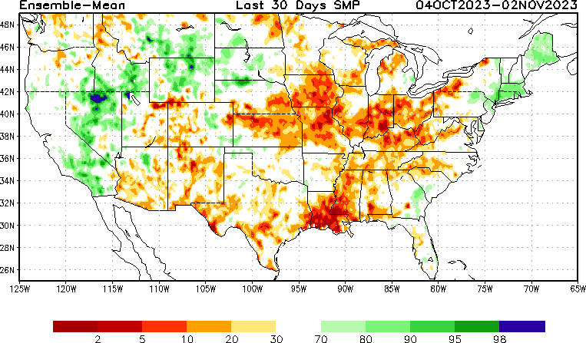
NLDAS Soil Moisture Model: Current Soil Moisture Anomaly

Slide 19
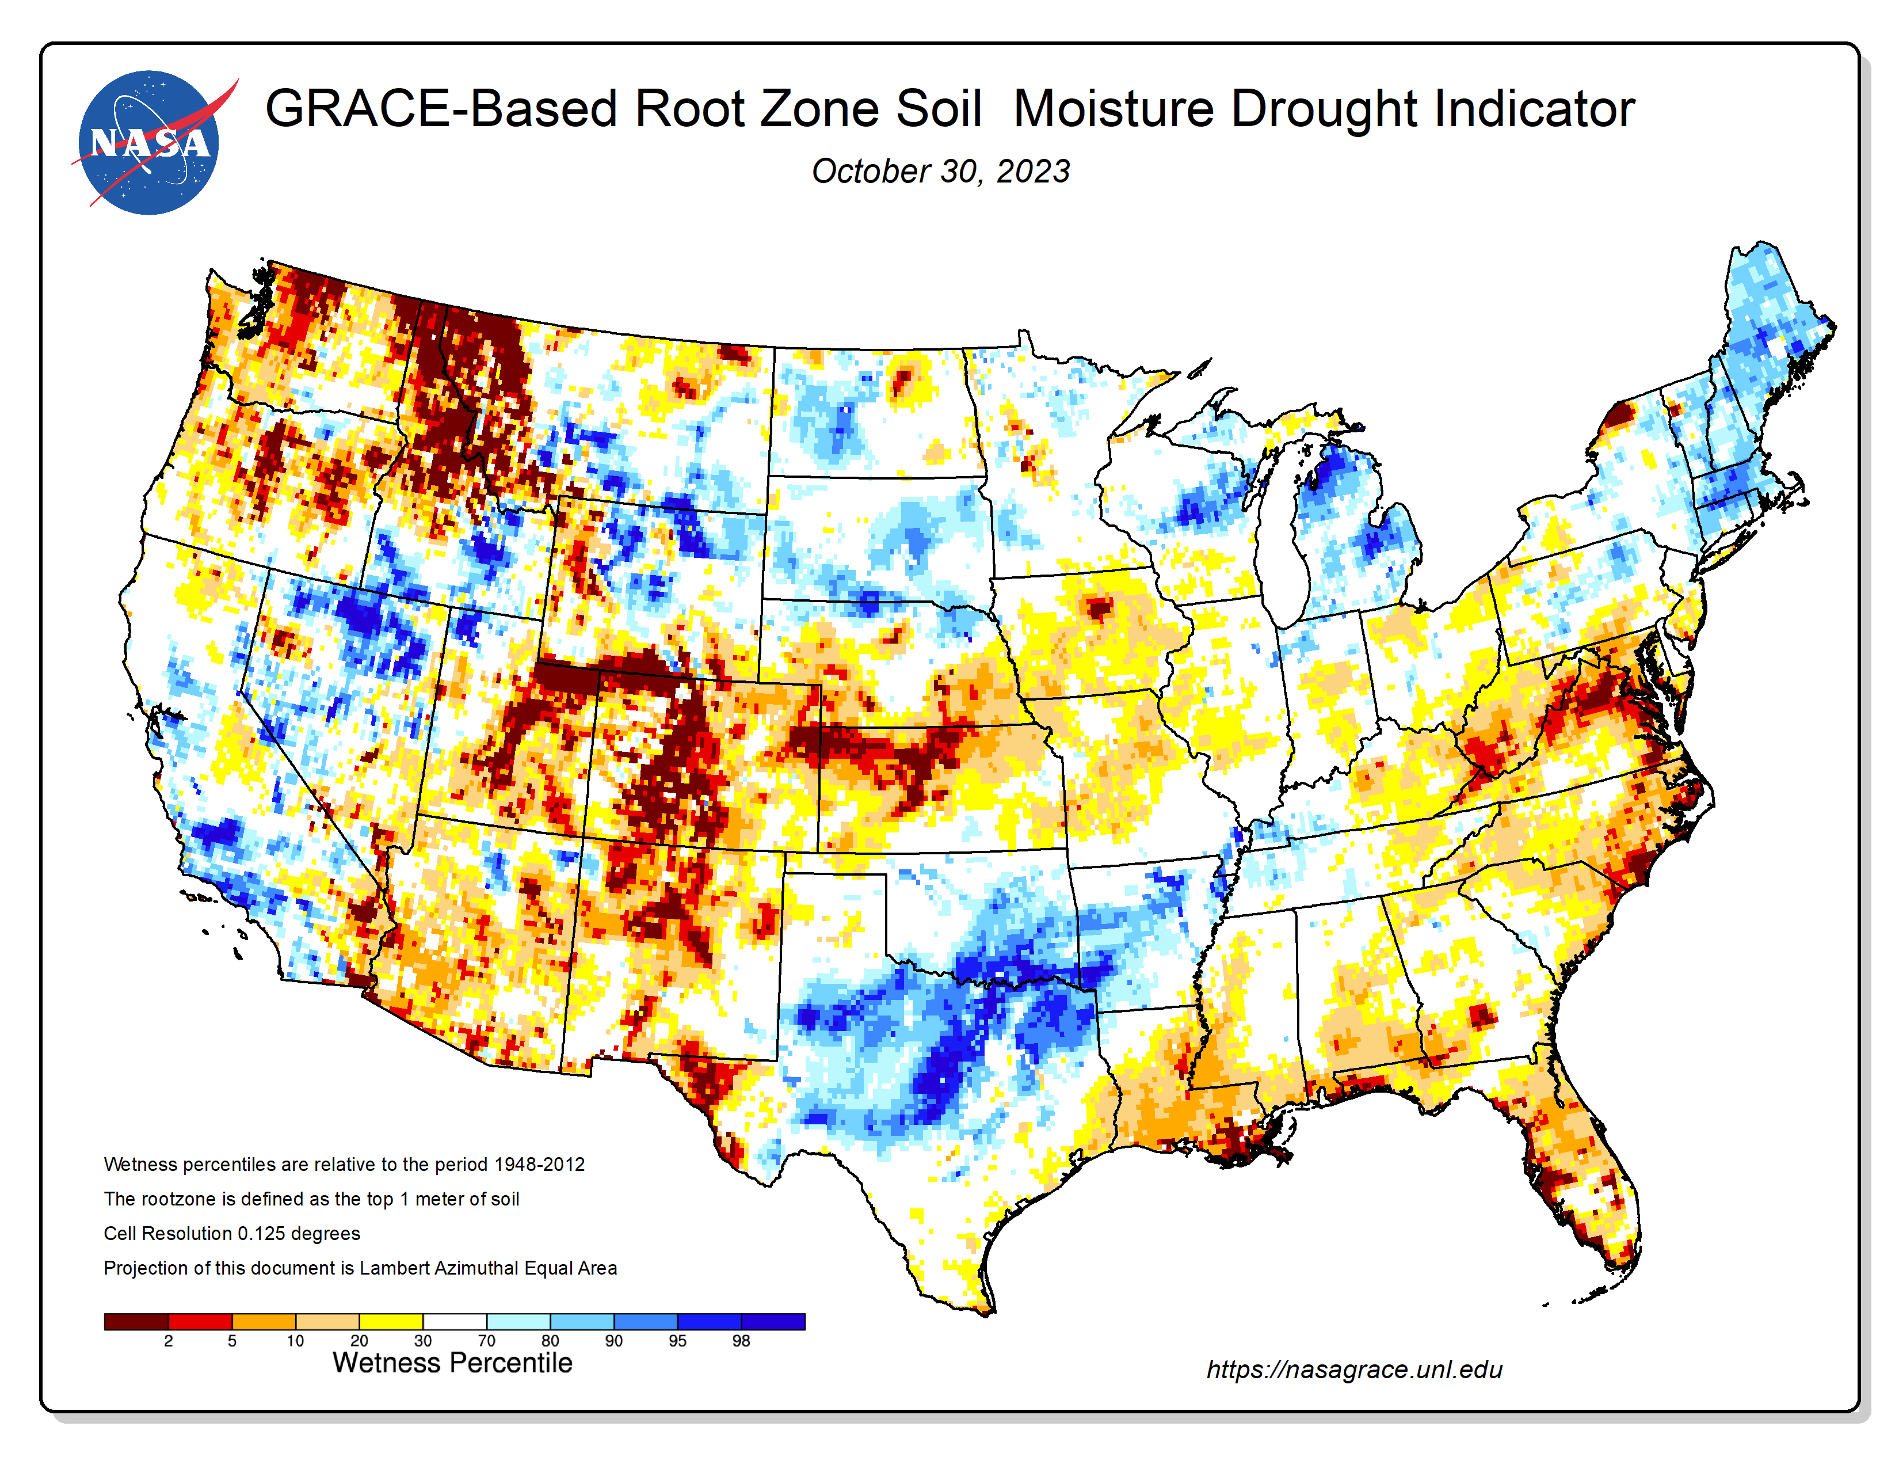
NASA GRACE-Based Root Zone Soil Moisture
https://nasagrace.unl.edu/

Slide 20
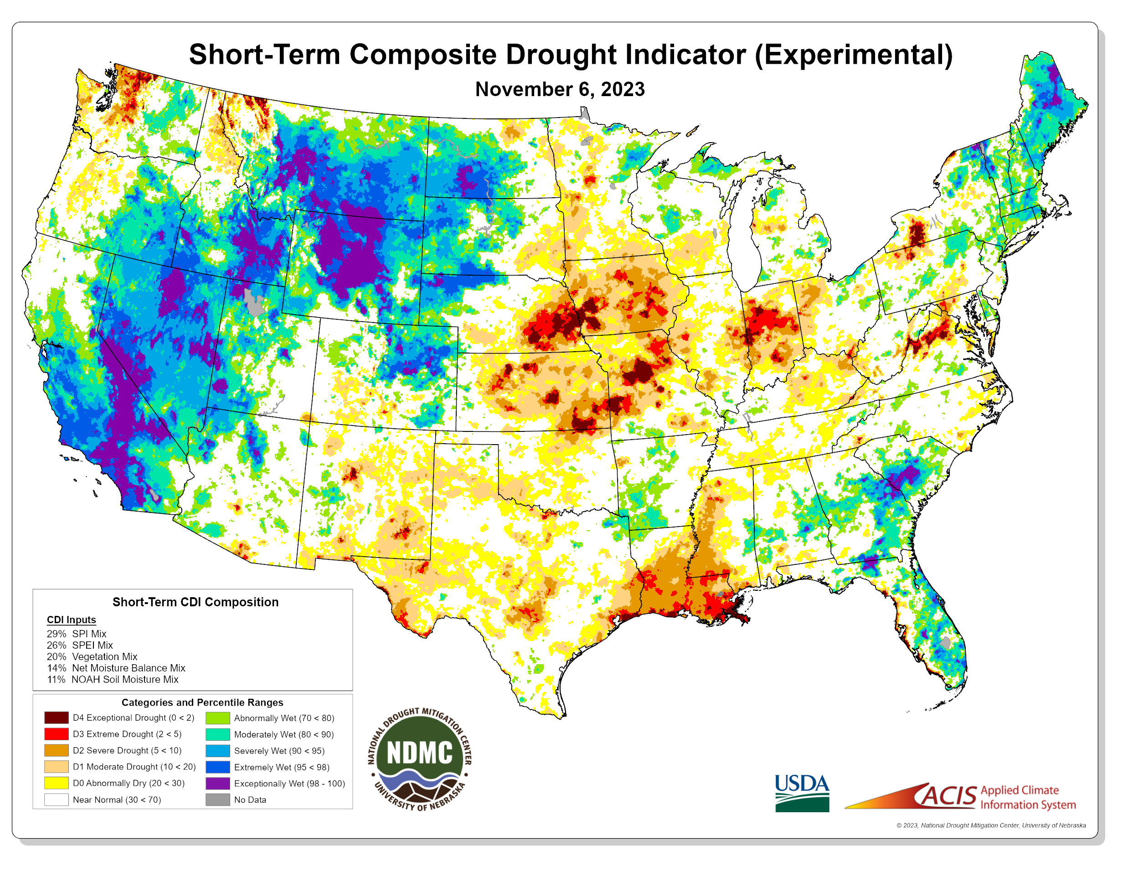
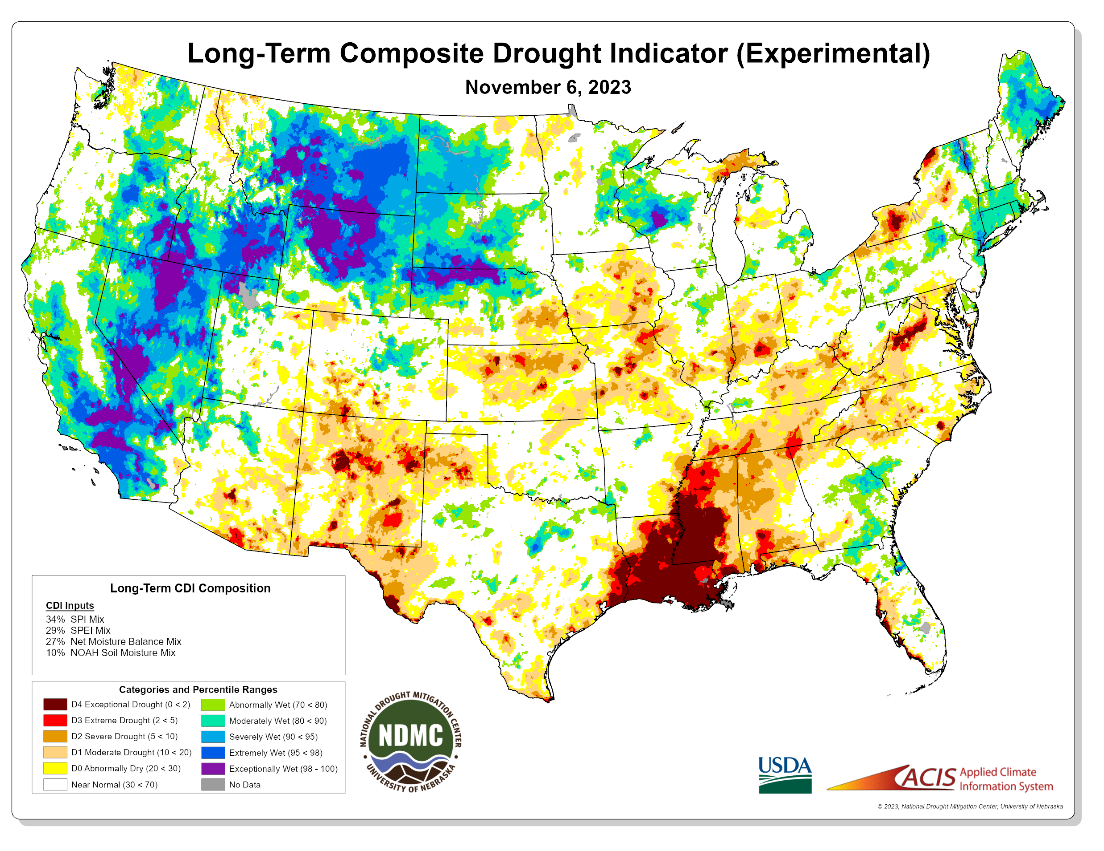
https://ndmcblends.unl.edu/
NDMC’s weekly Composite Drought Indicators (CDI’s) for both short-term and long-term drought

Slide 21
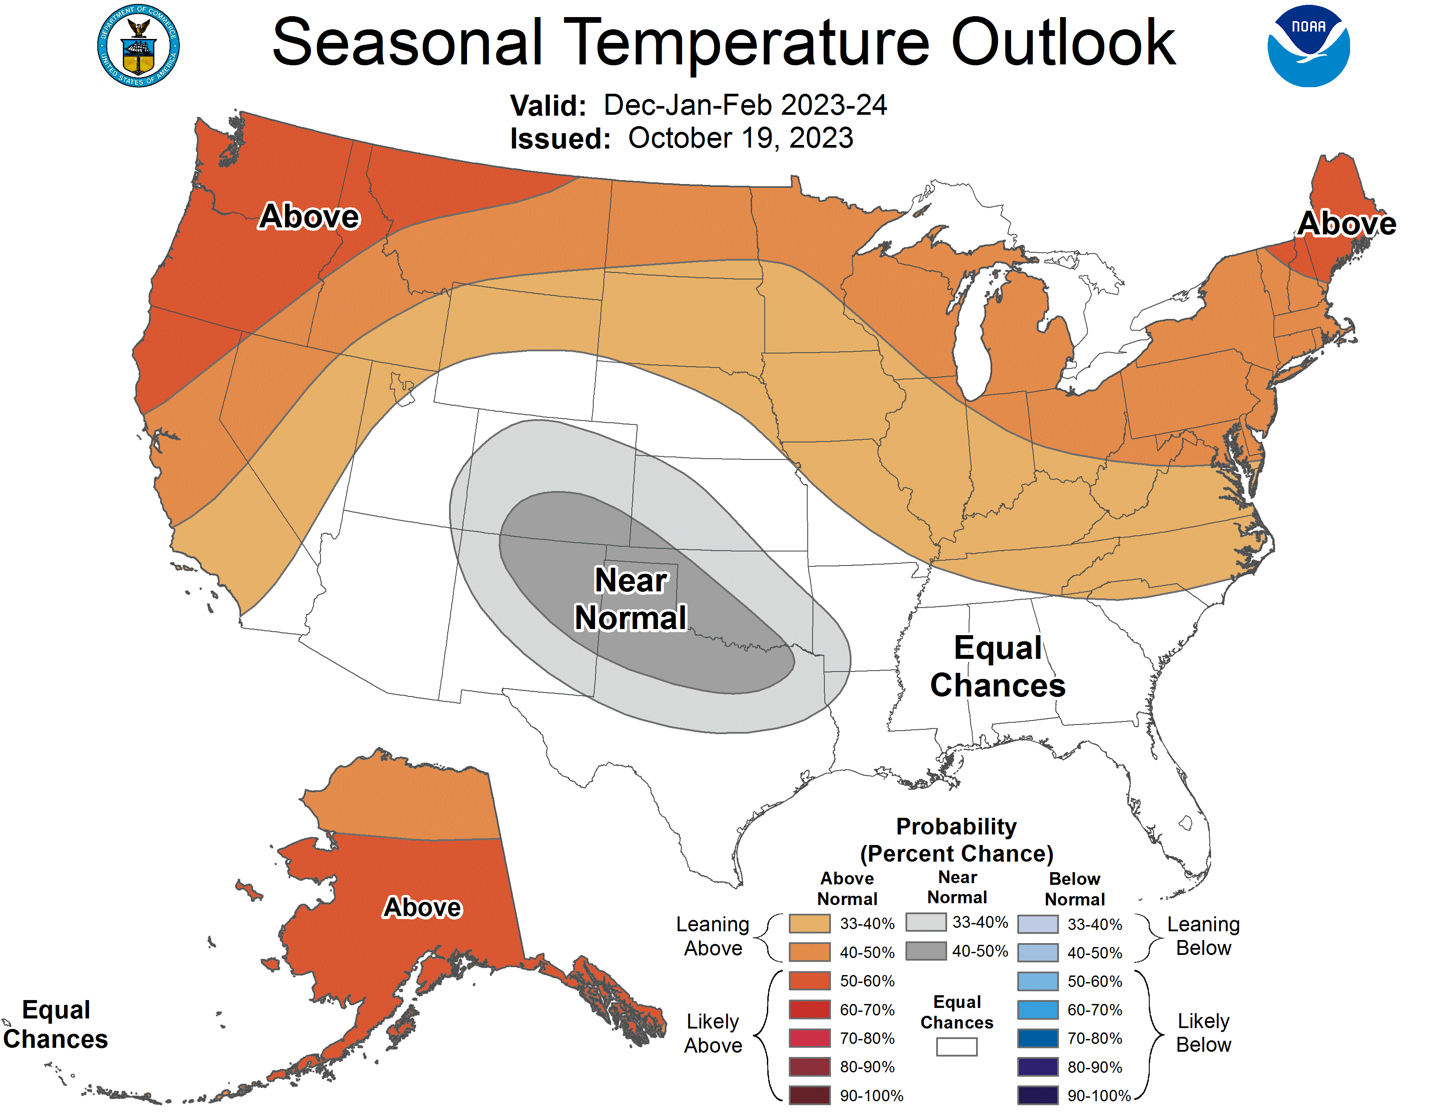
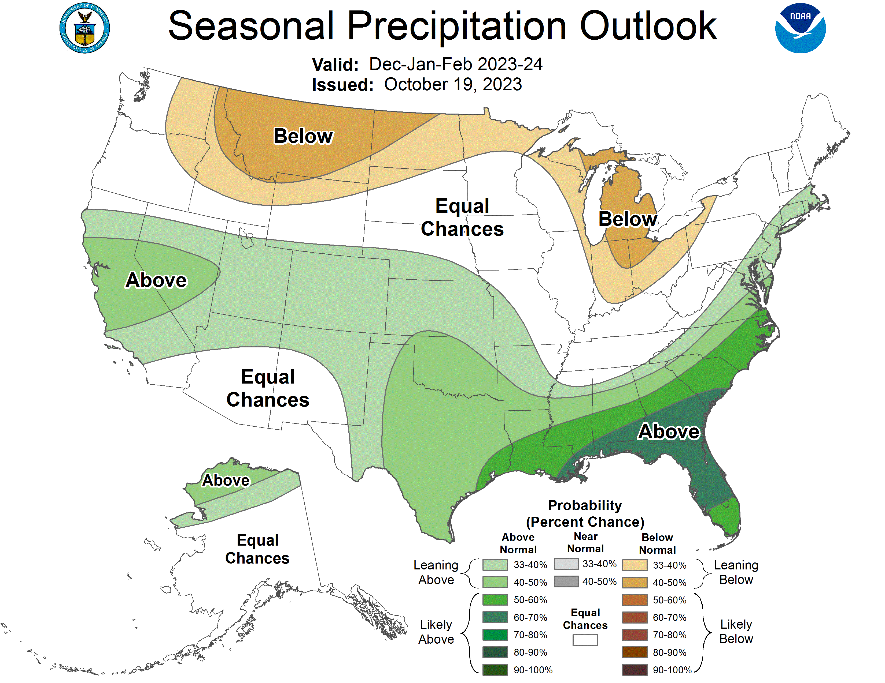
NOAA’s Official 3-Month Outlook

Slide 22
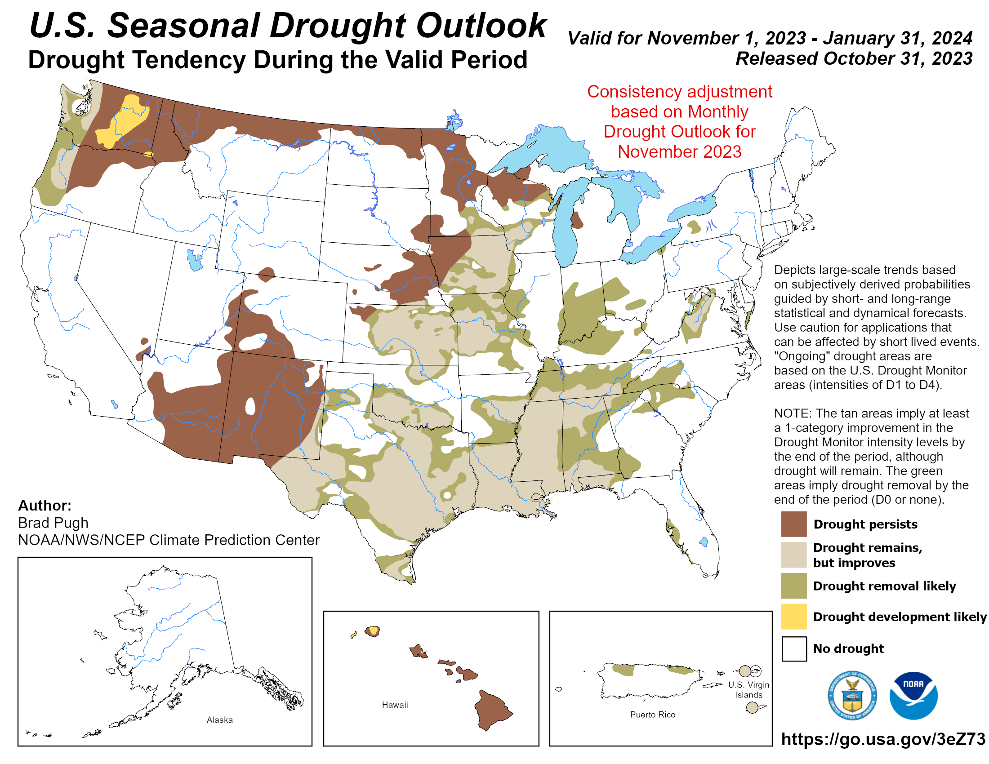

Slide 23
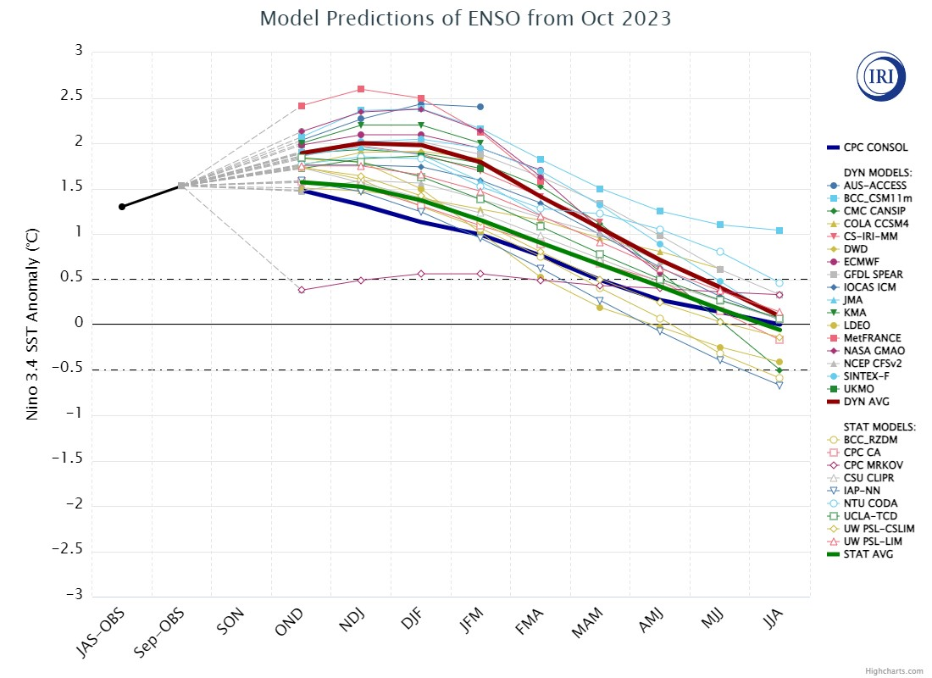
Anticipated El Nino Development?

Slide 24
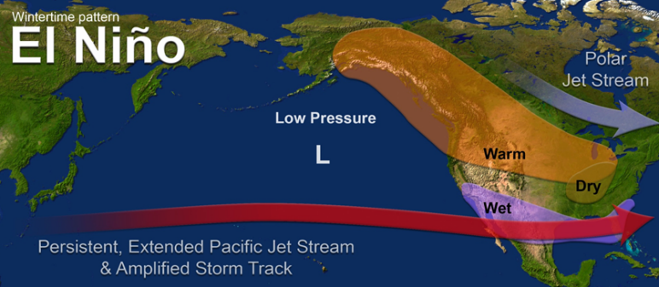
What does a typical El Nino pattern mean?
https://www.pmel.noaa.gov/elnino/sites/default/files/thumbnails/image/ElNinoJetWintertimePattern_NOAA_SRH.png

Slide 25
Climate/Drought Summary
Temperatures have been warmer than normal throughout the central to southern High Plains over the last 60-days and cooler than normal in the western portions of the region and warmer than normal in the east for the calendar year. Over the last 60 days, most all the High Plains was 2-4 degrees above normal, with even some greater departures in North Dakota.
Precipitation has been mixed in the region with portions of eastern Kansas, northern and central Nebraska, southern South Dakota and much of Wyoming and North Dakota above normal over the last 60 days which is helping with soil moisture recharge.
Nebraska is currently showing 24.81 percent of the state in drought with just under 11% in extreme drought or worse. Areas of the Panhandle into central Nebraska have had drought be eliminated with the recent wetter pattern.
The seasonal drought outlook that goes through the end of January 2024 has the current drought situation holding status quo during this time for most all the region with drought improvement expected to our south in Kansas into the southern Plains as well as in the Midwest.

Slide 26
Nebraska Water Supply Update…

Slide 27
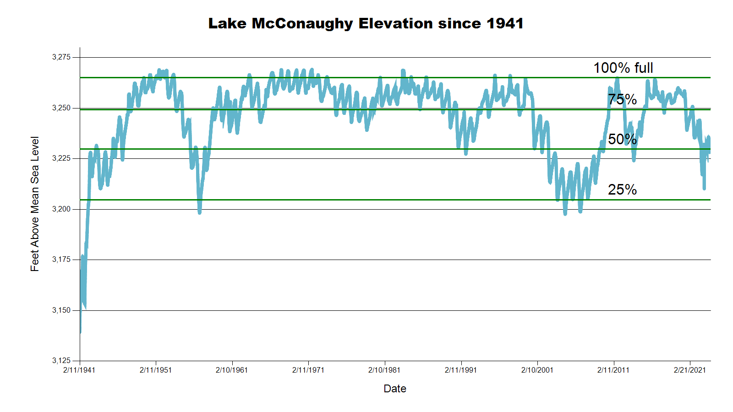
3234.6 feet 55.7% Full
SOURCE: CNPPID www.cnppid.com

Slide 28
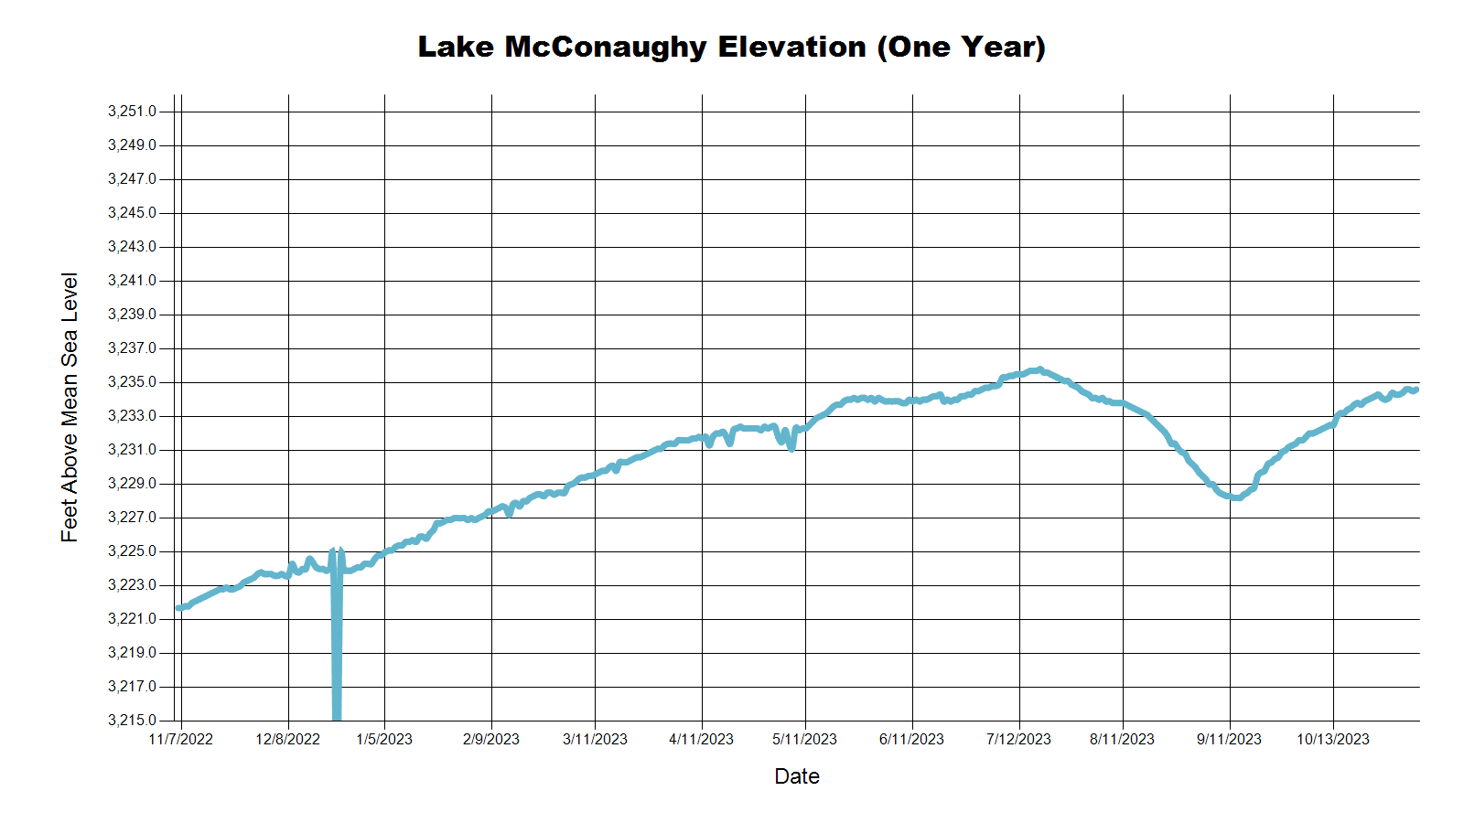
3223.2 Feet
42.7% of Max
July 2023
3234.6 Feet
55.7% of Max
November 2023
SOURCE: CNPPID www.cnppid.com

Slide 29
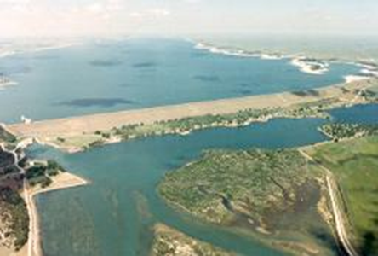
November 2023CARC Meeting
SOURCE: CNPPID www.cnppid.com

Slide 30
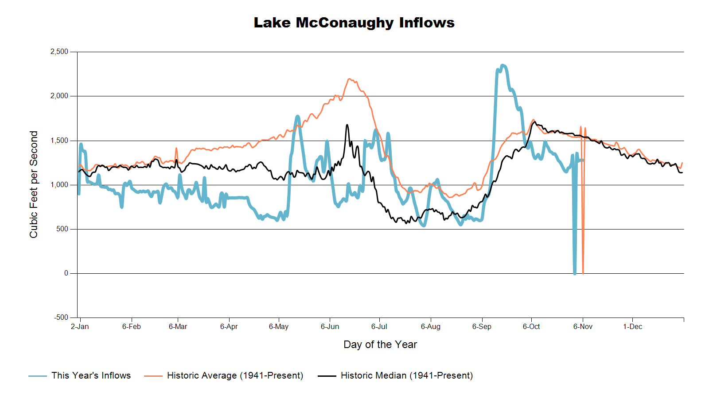

Slide 31
Lake McConaughy
Civil engineer Tyler Thulin reported that Lake McConaughy’s elevation currently is 3,231.5 feet, or 52% of maximum volume. He reported the lake elevation has risen 1.7 feet since the committee meeting on Sept. 22. Current inflows are around 1,400 cubic feet per second (cfs) and outflows are 0 due to the outage at Kingsley Hydroplant and Lake Ogallala being revovated by this Nebraska Game & Parks. The big lake will continue to fill with no outflows taking place during the outage.
SOURCE: CNPPID News Release October 5, 2023
www.cnppid.com

Slide 34
North Platte Basin data
https://www.usbr.gov/gp/lakes_reservoirs/wareprts/main_menu.html#supply

Slide 35
North Platte River Basin Inflow

Slide 36
North Platte River Basin Storage

Slide 37
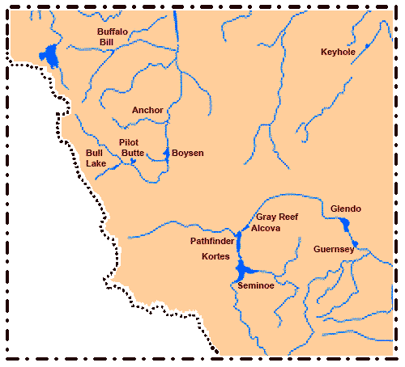
North Platte River Basin
Seminoe: 65.7% of conservation pool, 83.4% last CARC meeting
Pathfinder: 64.7% of conservation pool, 66.0% last CARC meeting
Glendo: 36.1% of conservation pool, 90.0% last CARC meeting
Alcova: 85.2% of conservation pool, 98.0% last CARC meeting
Source: BOR https://www.usbr.gov/gp/lakes_reservoirs/wyoming_lakes.html

Slide 38
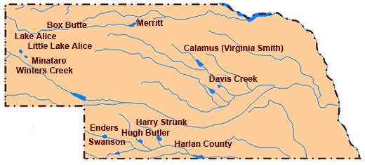
Republican River Basin
Hugh Butler: 43.7% (44.6%) of conservation pool
Enders: 17.6% (19.8%) of conservation pool
Harry Strunk: 74.5% (94.5%) of conservation pool
Swanson: 47.2% (49.9%) of conservation pool
*values in red are from the last CARC meeting
Source: BOR http://www.usbr.gov/gp/lakes_reservoirs

Slide 39
Republican River Basin
Harlan County Current Conditions
Conservation Pool is 67.3% full (78.8%)
211,453 Acre-Feet in storage compared to 247,516 Acre-Feet (AF) of water in storage during July 2023
Last year at this time, 227,361 AF was in storage (November 2023)
Historical average storage for this time of the year is 243,496 AF
*values in red are from the last CARC meeting
Source: BOR http://www.usbr.gov/gp/lakes_reservoirs/

Slide 40
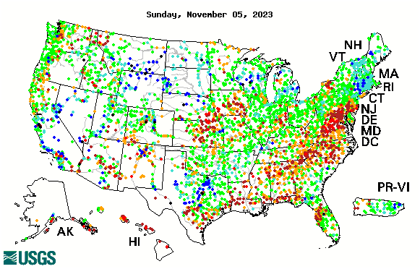

14-day average streamflow compared to historical streamflow for the day of year

Slide 41
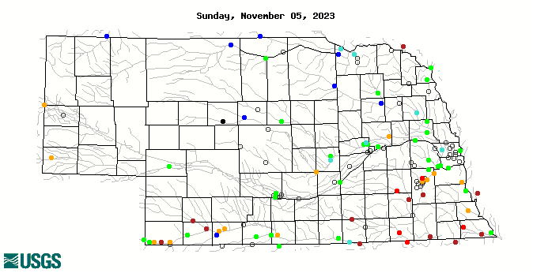
14-day average streamflow compared to historical streamflow for the day of year
95th Percentile
18th Percentile
53rd Percentile
3rd Percentile
16thPercentile
4thPercentile
7thPercentile

Slide 42
Water Supply Summary
Lake McConaughy is currently 55.7 percent of capacity and has been slowly rising due to some downstream maintenance and the end of the irrigation season.
Upstream reservoirs in Wyoming are reducing capacity for this time of year with most sending water downstream in preparation for the winter.
The Republican River basin reservoirs all have less water in storage than in July as the irrigation season utilized these reservoirs, especially in the drier south-central portion of the state.
Harlan County Reservoir is holding about 36,000 acre-feet less water now than in July and is also holding about 32,000 acre-feet less than the historical average for this time of year.

Slide 43
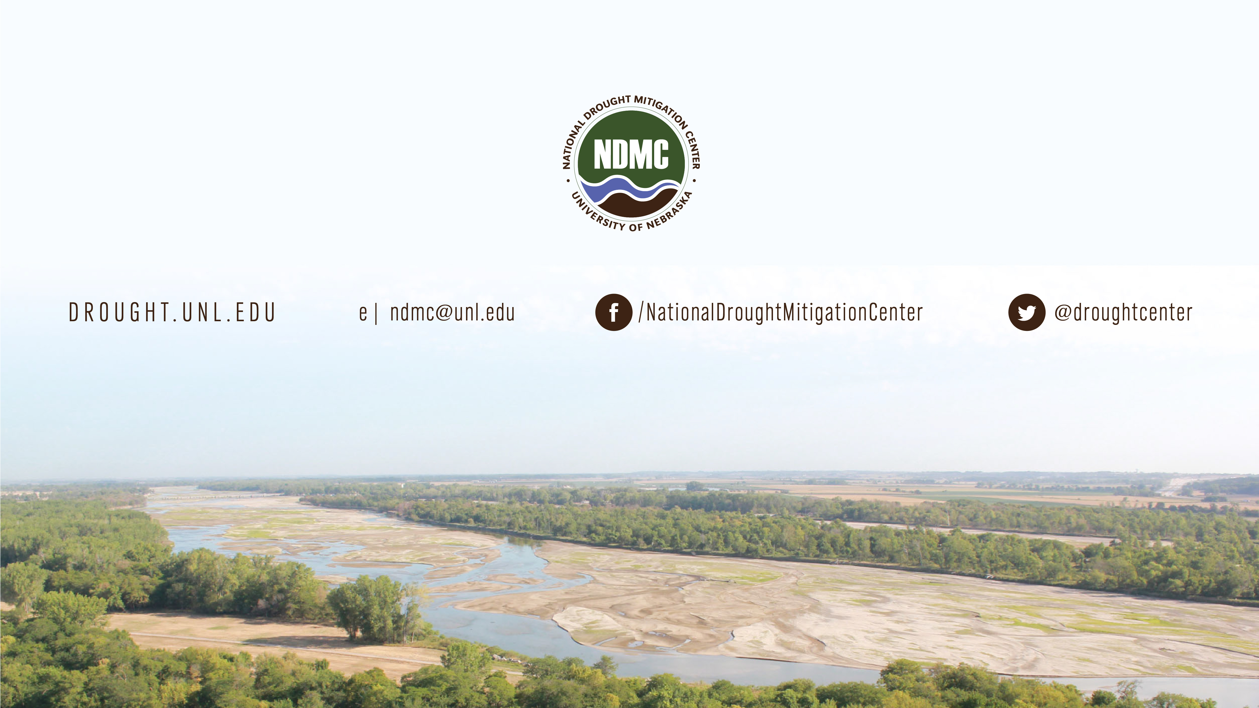
Brian Fuchs
bfuchs2@unl.edu
402-472-6775
National Drought Mitigation Center
School of Natural Resources
University of Nebraska-Lincoln

